Slide 2
Objectives Overview
Discuss the evolution of the Internet
Identify and briefly describe various broadband Internet connections and state differences between broadband Internet connections and dial-up connections
Describe the types of Internet access providers
Describe the purpose of an IP address and its relationship to a domain name
Explain the purpose of a Web browser and identify the components of a Web address
Describe how to use a search engine to search for information on the Web and differentiate between a search engine and a subject directory
See Page 73
for Detailed Objectives

Slide 3
Objectives Overview
Describe the types of Web sites
Explain how Web pages use graphics, animation, audio, video, virtual reality, and plug-ins
Identify and briefly describe the steps required for Web publishing
Describe the types of e-commerce
Explain how e-mail, mailing lists, instant messaging, chat rooms, VoIP, newsgroups and message boards, and FTP work
Identify the rules of netiquette
See Page 73
for Detailed Objectives

Slide 4
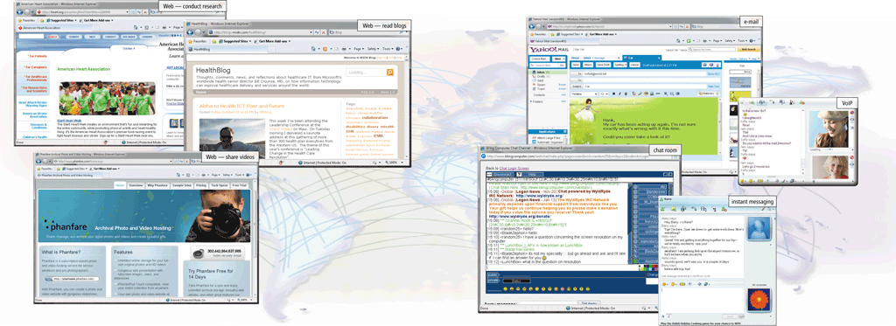
The Internet
The Internet is a worldwide collection of networks that links millions of businesses, government agencies, educational institutions, and individuals
Page 74
Figure 2-1

Slide 5
Evolution of the Internet
The Internet originated as ARPANET (Advanced Research Projects Agency Network) in September 1969 and had two main goals:
Allow scientists at different physical locations to share information and work together
Function even if part of the network were disabled or destroyed by a disaster
Page 75

Slide 6
Evolution of the Internet
1969 ARPANET becomes functional
1984 ARPANET has more than 1,000 individual computers linked as hosts
1986 NSF connects NSFnet to ARPANET and becomes known as the Internet
1995 NSFNet terminates its network on the Internet and resumes status as research network
Today More than 550 million hosts connect to the Internet
1996 Internet2 is founded
Pages 75 - 76

Slide 7
Evolution of the Internet
Each organization is responsible only for maintaining its own network
The World Wide Web Consortium (W3C) oversees, sets guidelines and standards
Internet2 connects more than 200 universities and 115 companies via a high-speed private network
Page 76

Slide 8
Evolution of the Internet
Many home and small business users connect to the Internet via high-speed broadband Internet service
Cable Internet service
DSL
Fiber to the Premises (FTTP)
Fixed wireless
Cellular Radio Network
Wi-Fi
Satellite Internet Service
Page 76

Slide 9
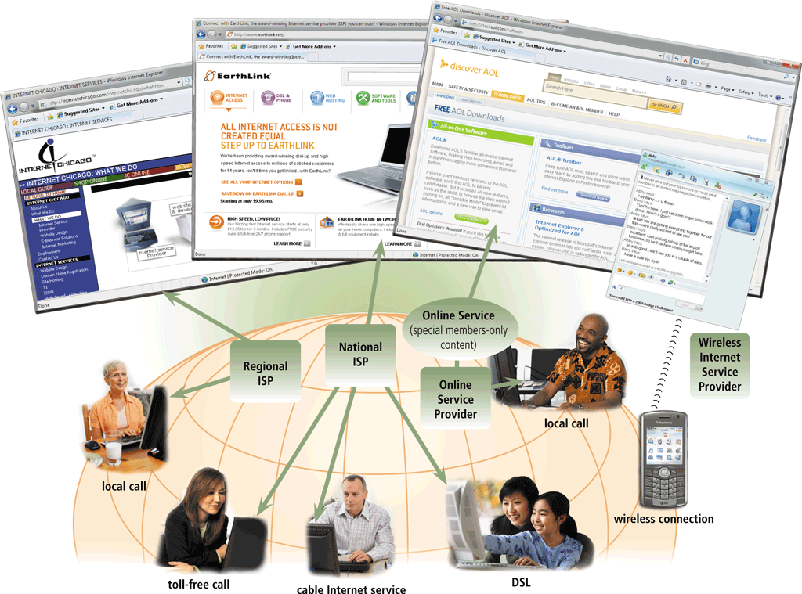
Evolution of the Internet
An access provider is a business that provides individuals and organizations access to the Internet free or for a fee
Page 77
Figure 2-2

Slide 10
Evolution of the Internet
ISP (Internet service provider)
Online service provider (OSP)
Wireless Internet service provider
Regional ISPs provide Internet access to a specific geographical area
National ISPs provide Internet access in cities and towns nationwide
Has many members-only features
Popular OSPs include AOL (America Online) and MSN (Microsoft Network)
Provides wireless Internet access to computers and mobile devices
Requires a wireless modem
Page 78

Slide 11
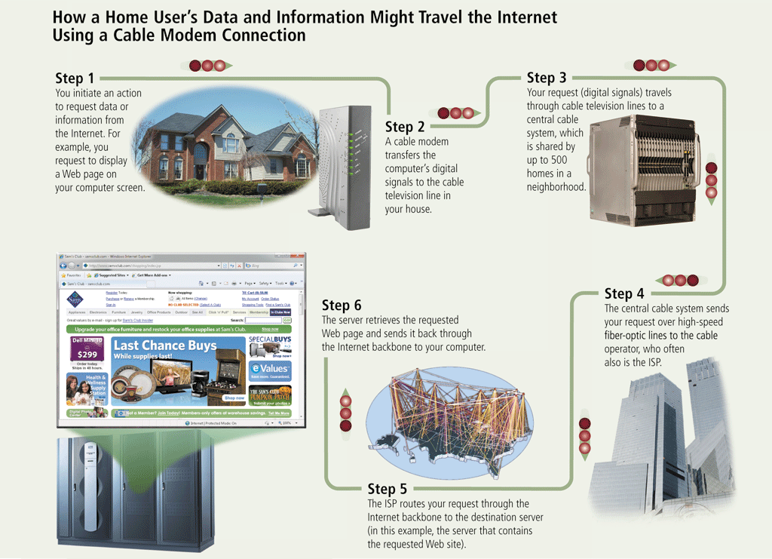
Evolution of the Internet
Page 79
Figure 2-3

Slide 12

Evolution of the Internet
An IP address is a number that uniquely identifies each computer or device connected to the Internet
A domain name is the text version of an IP address
Top-level domain (TLD)
A DNS server translates the domain name into its associated IP address
Pages 79 – 80
Figure 2-4

Slide 13
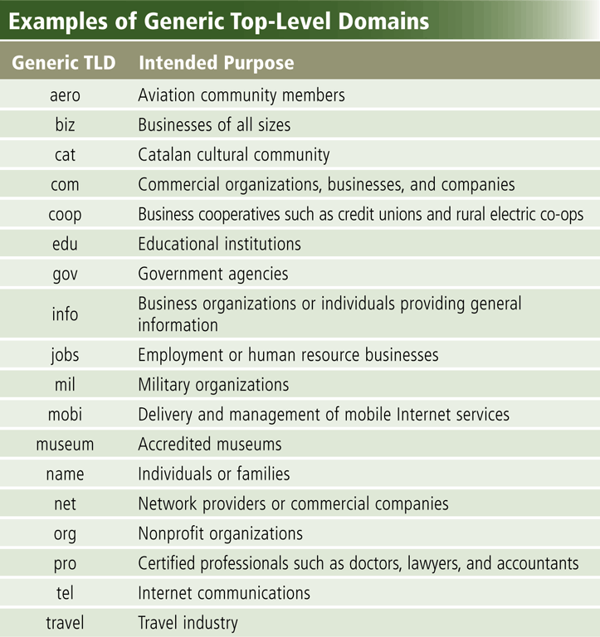
Evolution of the Internet
Page 80
Figure 2-5

Slide 14
The World Wide Web
The World Wide Web, or Web, consists of a worldwide collection of electronic documents (Web pages)
A Web site is a collection of related Web pages and associated items
A Web server is a computer that delivers requested Web pages to your computer
Web 2.0 refers to Web sites that provide a means for users to interact
Pages 80 - 81

Slide 15
The World Wide Web
A Web browser, or browser, allows users to access Web pages and Web 2.0 programs
Internet Explorer
Firefox
Opera
Safari
Google Chrome
Page 81

Slide 16
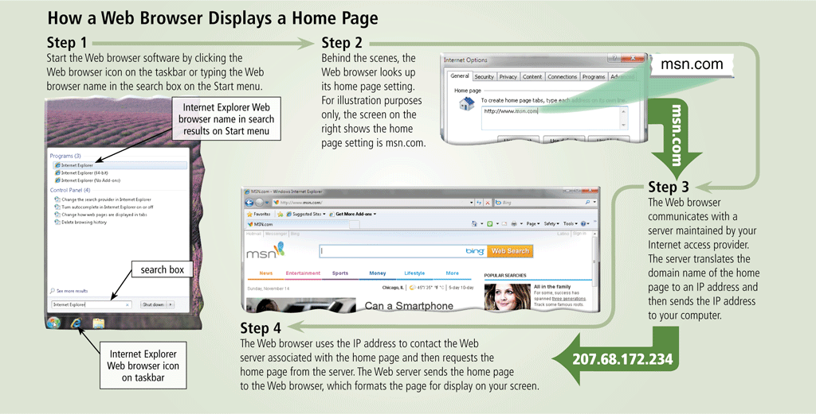
The World Wide Web
Page 81
Figure 2-6

Slide 17
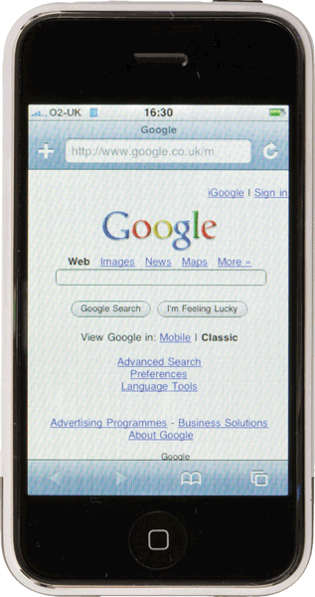
The World Wide Web
A home page is the first page that a Web site displays
Web pages provide links to other related Web pages
Surfing the Web
Downloading is the process of receiving information
Some Web pages are designed specifically for microbrowsers
Pages 82 - 83
Figure 2-7

Slide 18
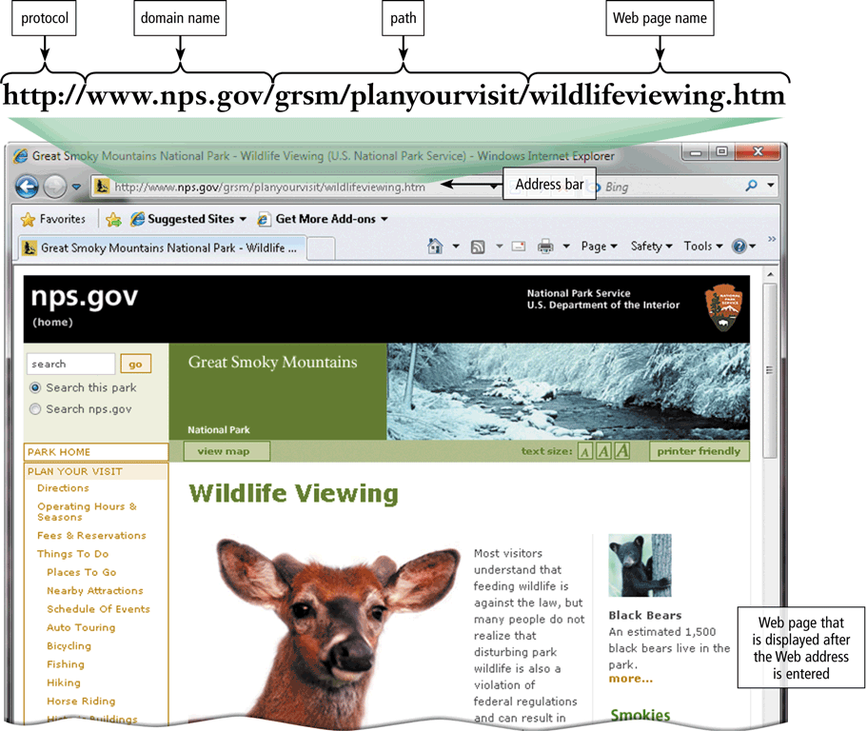
The World Wide Web
A Web page has a unique address called a URL or Web address
Pages 82 – 83
Figure 2-8

Slide 19
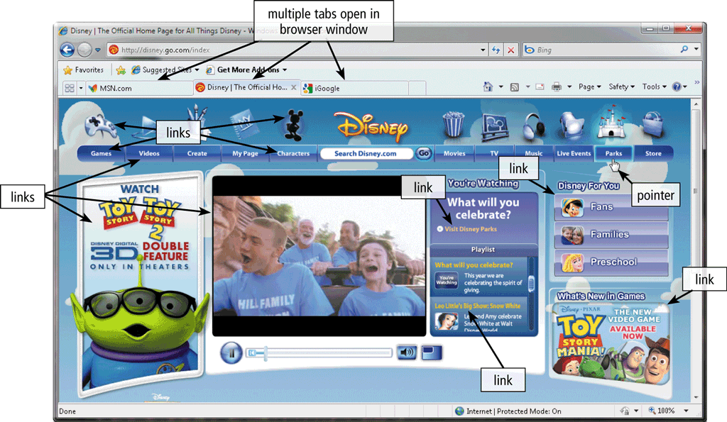
The World Wide Web
Tabbed browsing allows you to open and view multiple Web pages in a single Web browser window
Page 84
Figure 2-9

Slide 20
The World Wide Web
Two types of search tools are search engines and subject directories
Search engine
Finds information related to a specific topic
Subject directory
Classifies Web pages in an organized set of categories
Page 85

Slide 21
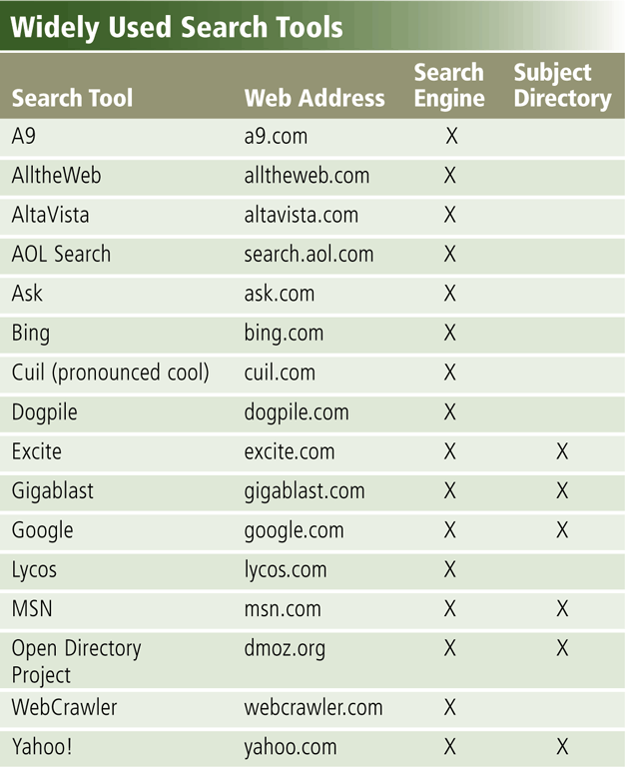
The World Wide Web
Page 85
Figure 2-10

Slide 22
The World Wide Web
A search engine is helpful in locating items such as:
Images
Videos
Audio
Publications
Maps
People or Businesses
Blogs
Page 85

Slide 23
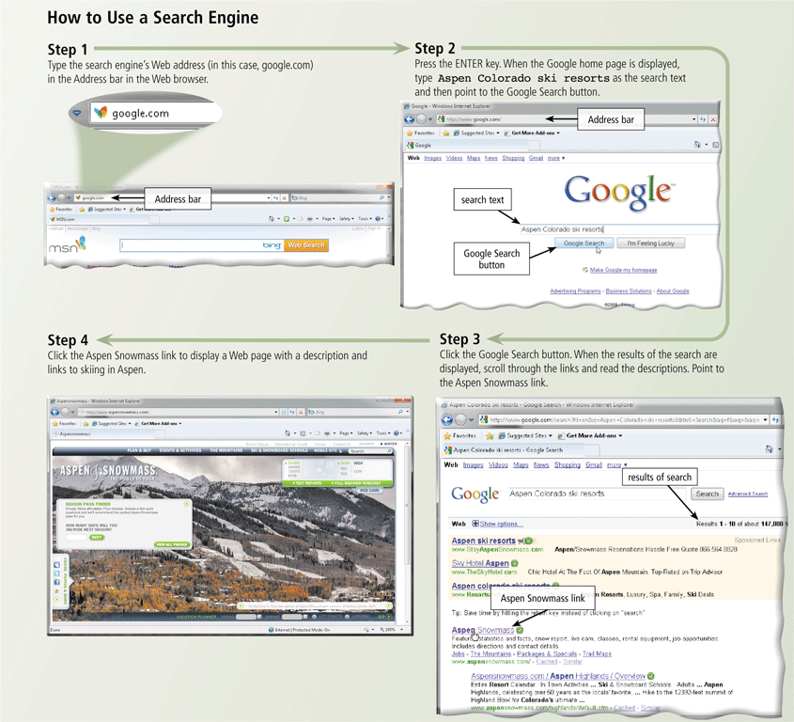
The World Wide Web
Page 86
Figure 2-11

Slide 24
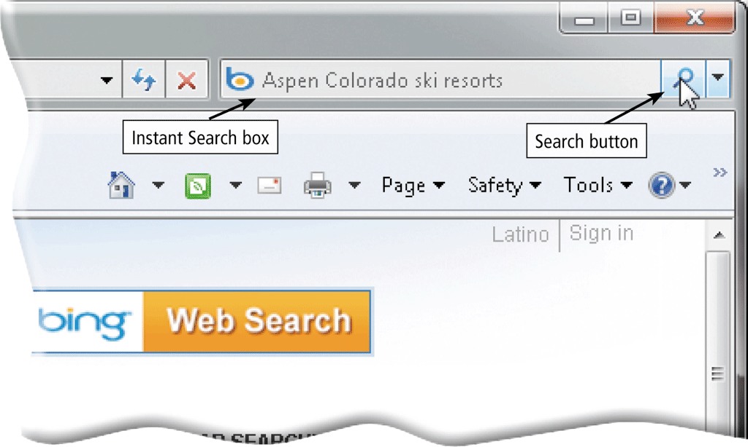
The World Wide Web
Some Web browsers contain an Instant Search box to eliminate the steps of displaying the search engine’s Web page prior to entering the search text
Page 87
Figure 2-12

Slide 25
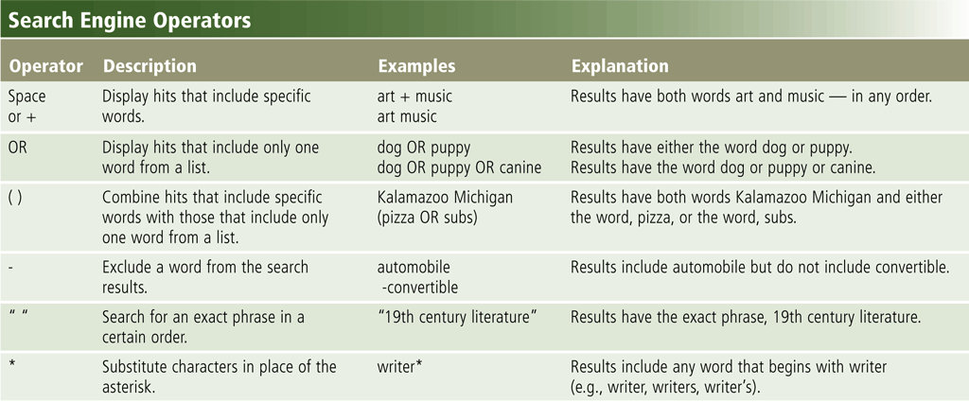
The World Wide Web
Search operators can help to refine your search
Page 87
Figure 2-13

Slide 26
The World Wide Web
There are thirteen types of Web sites
Portal
News
Informational
Business/Marketing
Blog
Online Social Network
Educational
Wiki
Pages 88 – 91
Figure 2-15

Slide 27
The World Wide Web
Entertainment
Advocacy
Web Application
Content Aggregator
Personal
Pages 91 – 92
Figure 2-15

Slide 28
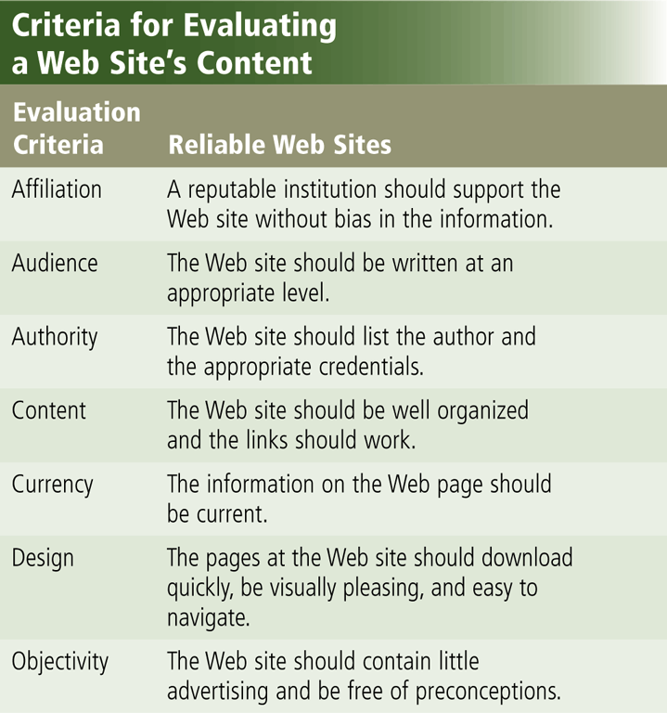
The World Wide Web
Information presented on the Web must be evaluated for accuracy
No one oversees the content of Web pages
Page 92
Figure 2-16

Slide 29
The World Wide Web
Multimedia refers to any application that combines text with:
Graphics
Animation
Audio
Video
Virtual Reality
Page 92

Slide 30
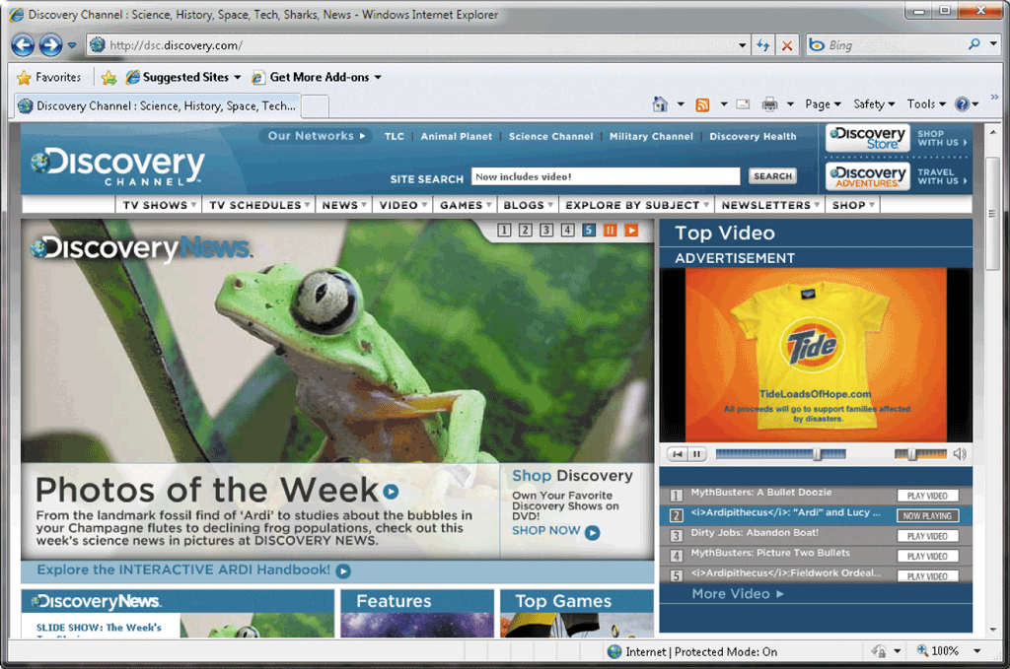
The World Wide Web
A graphic is a digital representation of nontext information
Graphic formats include BMP, GIF, JPEG, PNG, and TIFF
Page 93
Figure 2-17

Slide 31
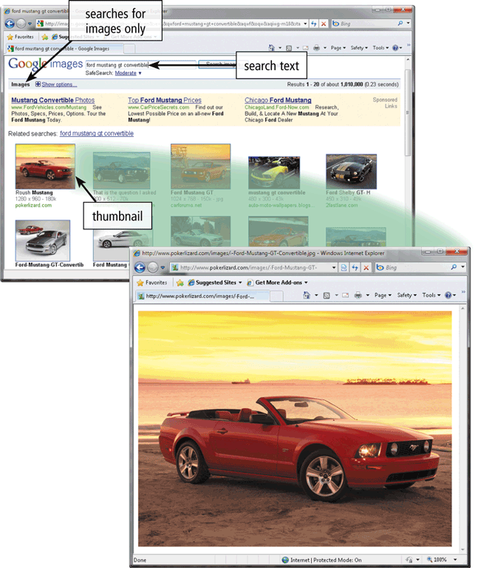
The World Wide Web
A thumbnail is a small version of a larger graphic
Page 94
Figure 2-19

Slide 32
The World Wide Web
Animation is the appearance of motion created by displaying a series of still images in sequence
Page 94

Slide 33
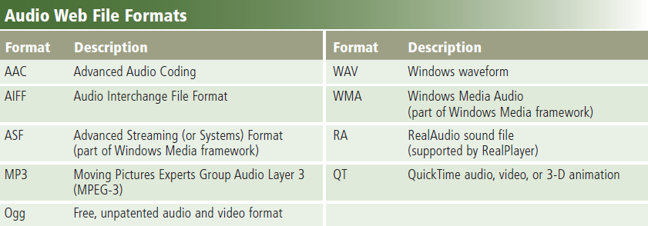
The World Wide Web
Audio includes music, speech, or any other sound
Compressed to reduce file size
You listen to audio on your computer using a player
Streaming is the process of transferring data in a continuous and even flow
Pages 94 – 95
Figure 2-20

Slide 34
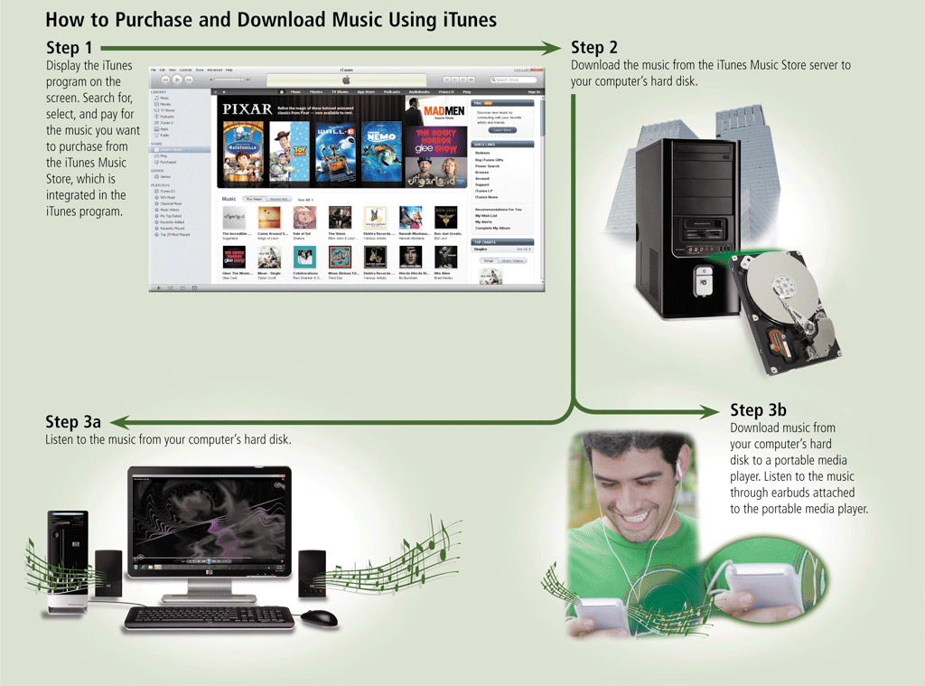
The World Wide Web
Page 95
Figure 2-21

Slide 35
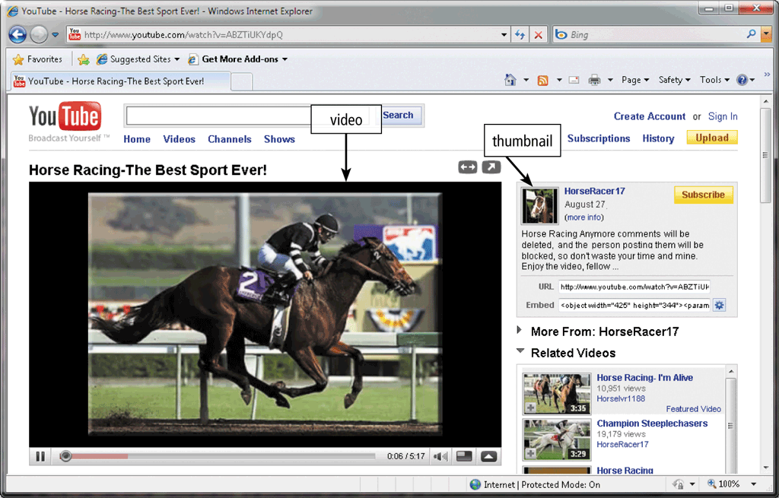
The World Wide Web
Video consists of images displayed in motion
Page 96
Figure 2-22

Slide 36
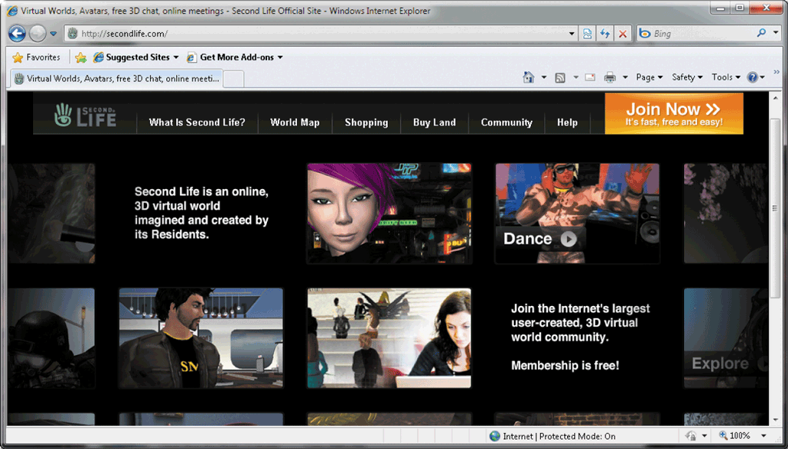
The World Wide Web
Virtual reality (VR) is the use of computers to simulate a real or imagined environment that appears as a three-dimensional space
Pages 96 – 97
Figure 2-23

Slide 37
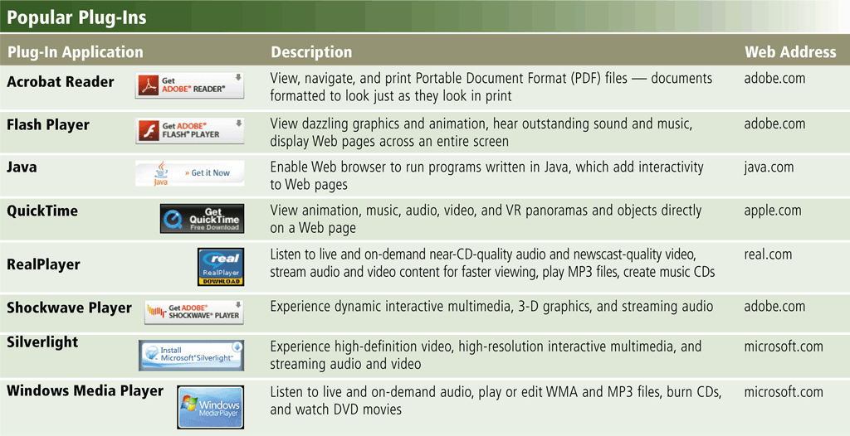
The World Wide Web
A plug-in is a program that extends the capability of a Web browser
Page 97
Figure 2-24

Slide 38
The World Wide Web
Web publishing is the development and maintenance of Web pages
Plan a Web site
Analyze and design a Web site
Create a Web site
Deploy a Web site
Maintain a Web site
Page 98

Slide 39
E-Commerce
E-commerce is a business transaction that occurs over an electronic network
M-commerce identifies e-commerce that takes place using mobile devices
Page 98

Slide 40
E-Commerce
Consumer-to-consumer (C2C)
Business-to-business (B2B)
Business-to-consumer (B2C)
E-commerce
Pages 98 - 99

Slide 41
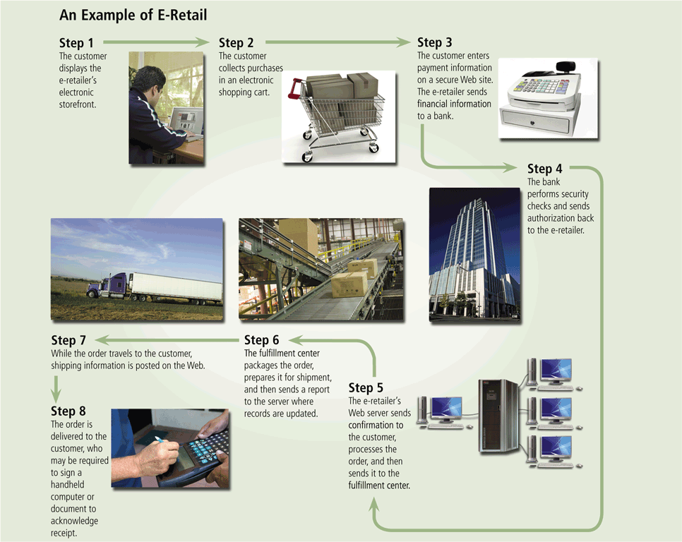
E-Commerce
Page 99
Figure 2-25

Slide 42
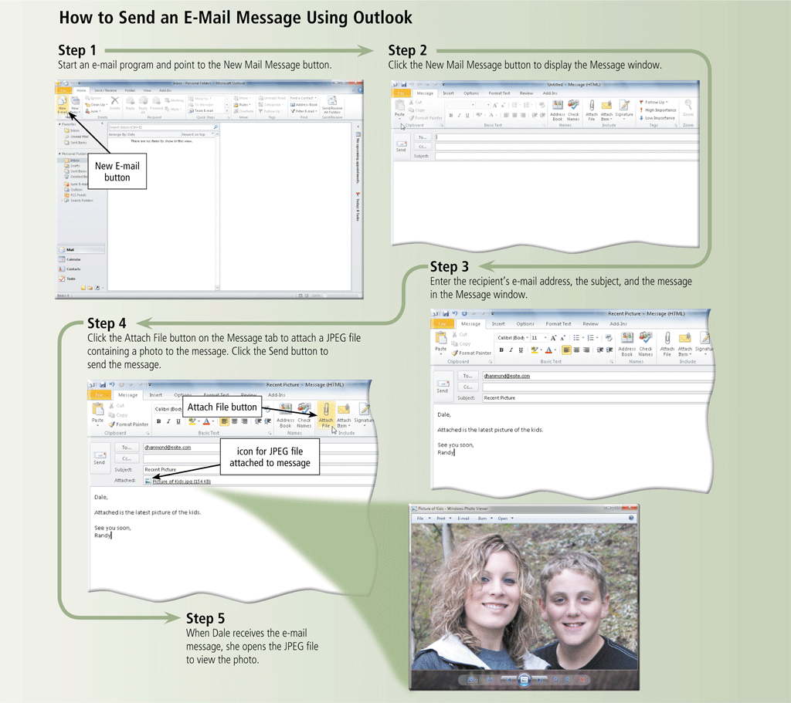
Other Internet Services
E-mail is the transmission of messages and files via a computer network
An e-mail program allows you to create, send, receive, forward, store, print, and delete e-mail messages
Page 101
Figure 2-26

Slide 43
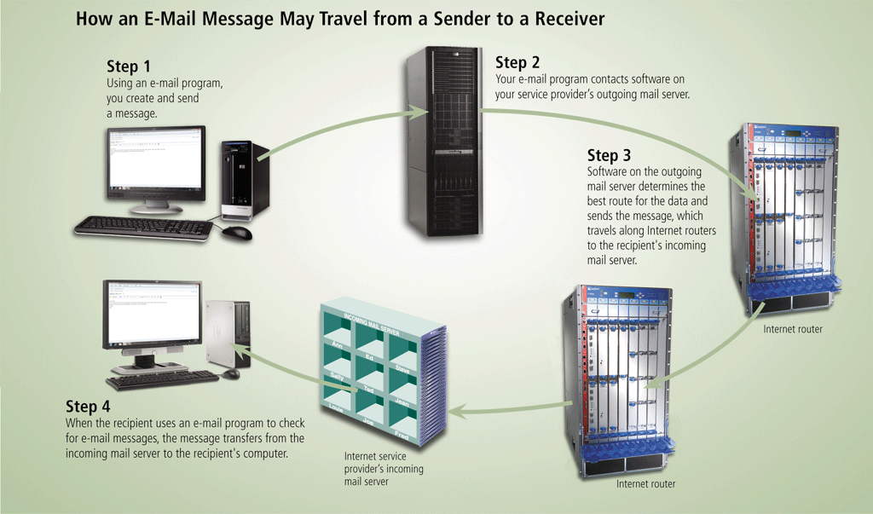
Other Internet Services
Page 102
Figure 2-27

Slide 44
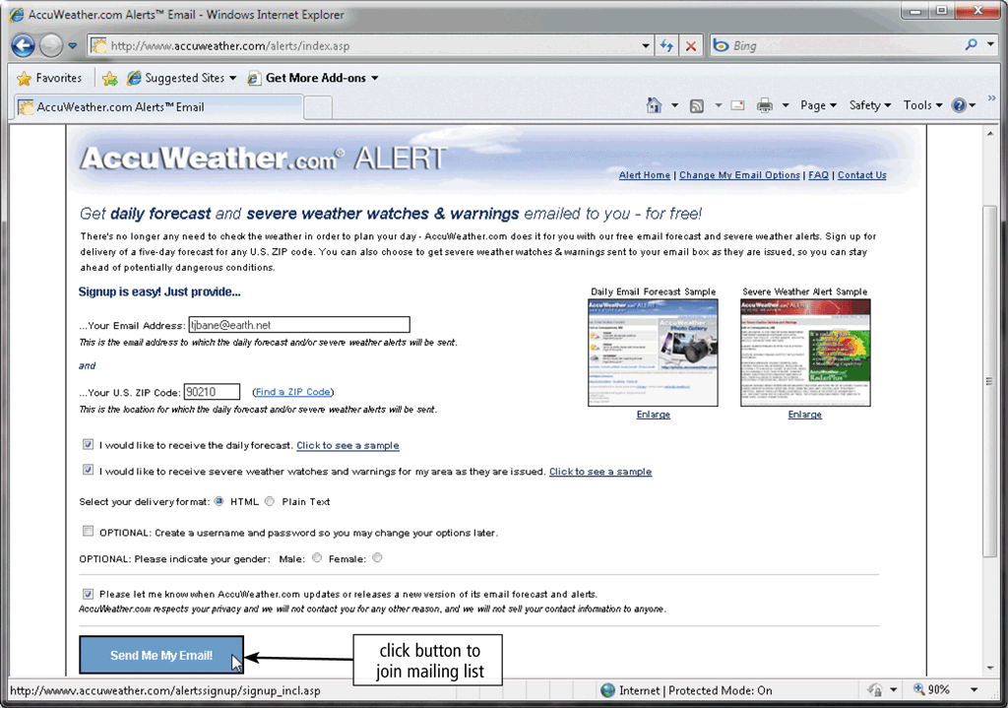
Other Internet Services
A mailing list is a group of e-mail names and addresses given a single name
Subscribing adds your e-mail name and address
Unsubscribing removes your name
Page 103
Figure 2-28

Slide 45
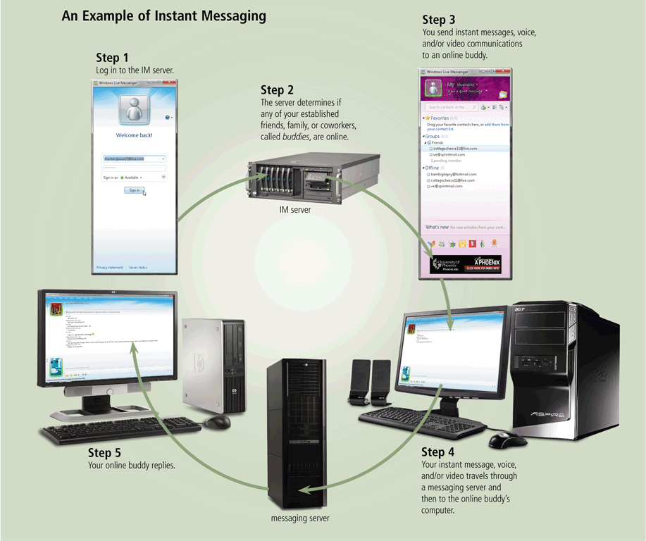
Other Internet Services
Instant messaging (IM) is a real-time Internet communications service
Page 104
Figure 2-29

Slide 46
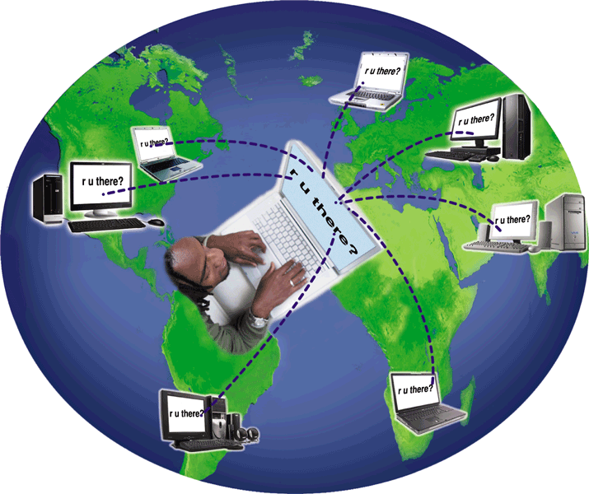
Other Internet Services
A chat is a real-time typed conversation that takes place on a computer
A chat room is a location on an Internet server that permits users to chat with each other
Page 105
Figure 2-30

Slide 47
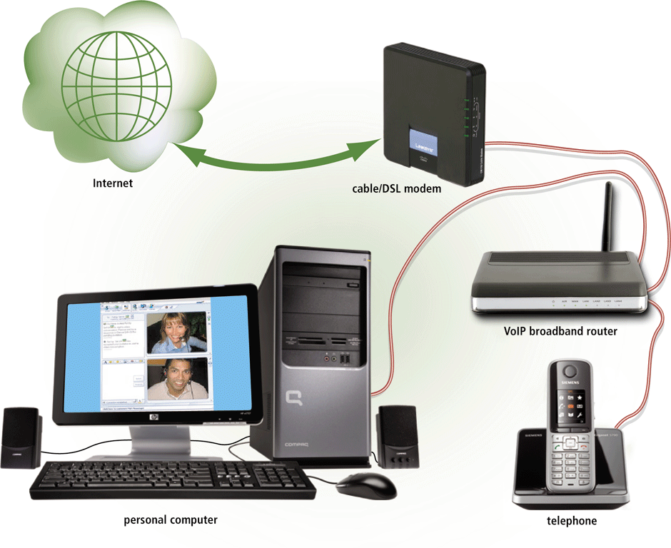
Other Internet Services
VoIP (Voice over IP) enables users to speak to other users over the Internet
Also called Internet telephony
Page 106
Figure 2-31

Slide 48
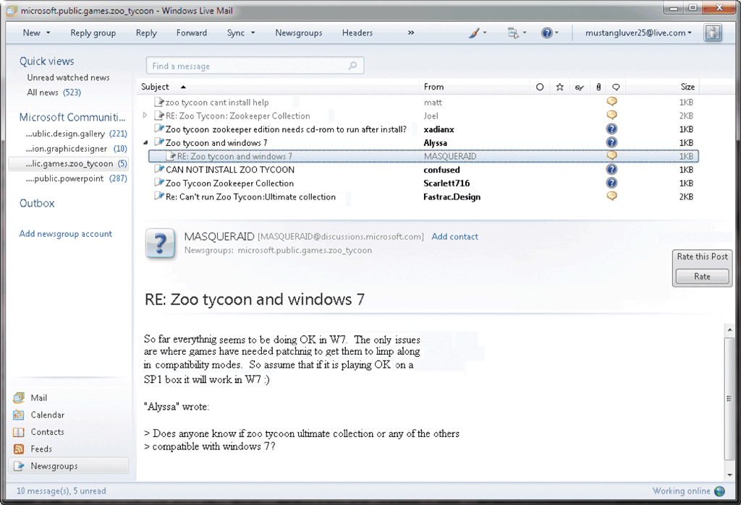
Other Internet Services
A newsgroup is an online area in which users have written discussions about a particular subject
Typically requires a newsreader
A message board is a Web-based type of discussion group
Page 107
Figure 2-32

Slide 49
Other Internet Services
FTP (File Transfer Protocol) is an Internet standard that permits file uploading and downloading with other computers on the Internet
Many operating systems include FTP capabilities
An FTP server is a computer that allows users to upload and/or download files using FTP
Page 107

Slide 50
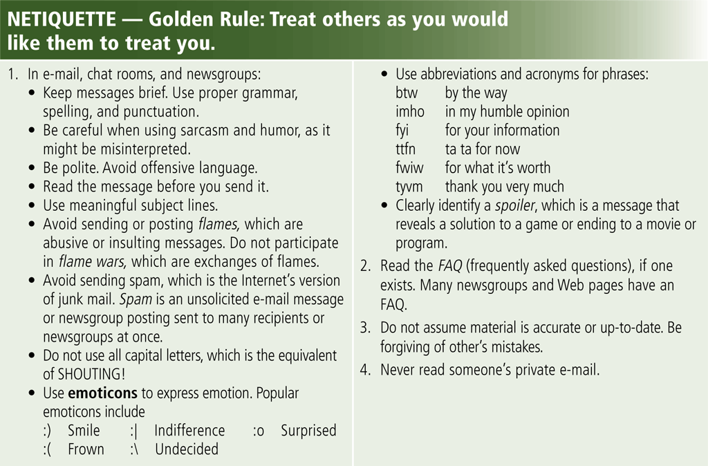
Netiquette
Netiquette is the code of acceptable Internet behavior
Page 108
Figure 2-33

Slide 51
Summary
History and structure of the Internet
World Wide Web
Browsing, navigating, searching, Web publishing, and e-commerce
Other Internet services: e-mail, instant messaging, chat rooms, VoIP, newsgroups and message boards, and FTP
Rules of netiquette
Page 109

Slide 52
Chapter 2 Complete

